Slide 1


INTERACTIVE QUIZ GAME
Revolutionizing interactive learning with an engaging, adaptive and fun experience

Slide 2
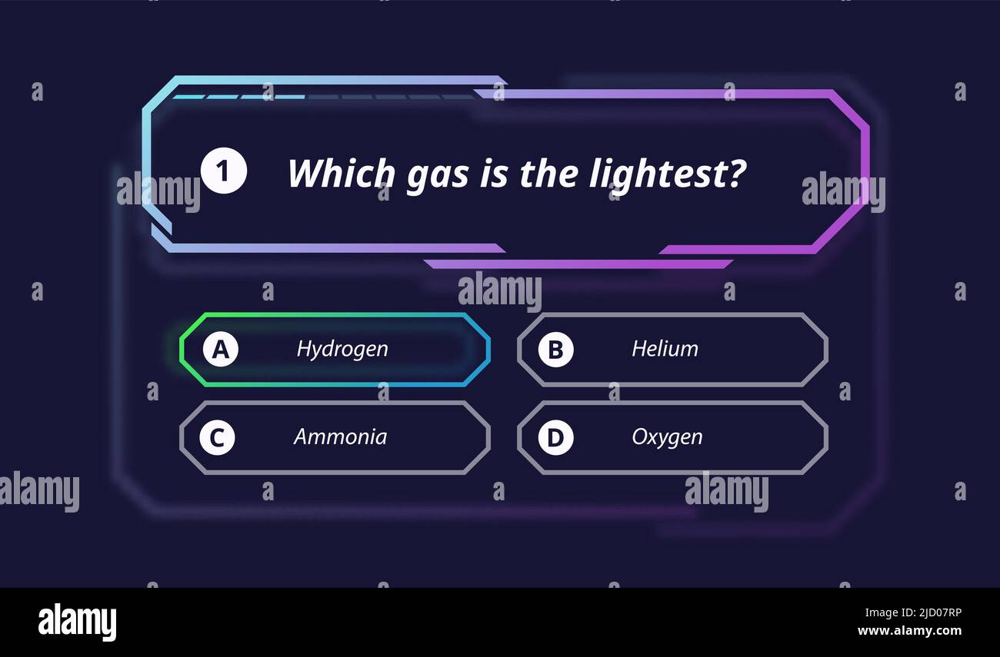
Abstract
This project is an interactive quiz game developed using HTML, CSS, and JavaScript. This application allows users to answer multiple-choice questions, tracks their score, and displays win or lose results. The main theme of the project is to generate a fun, engaging, and beginner-friendly web game while learning front-end development concepts.

Slide 3
About the Project
This interactive Quiz Game is a web-based application which is developed to test the knowledge of users in History, Geography, Programming and General Knowledge through multiple-choice questions.
This provides fun and engaging learning experience with a simple interface and real-time score tracking.
This project is designed using HTML for structure, CSS for styling, and JavaScript for game logic and interactivity.
This quiz game displays questions one by one, checks answers instantly, updates the score, and shows the final result as Win or Lose.
It can be easily accessed through any web browser without installing additional software.

Slide 4
Core Features of Our Quiz Game
Dynamic Question Display
Real-time score tracking
Instant Feedback and Scoring
Flexible Quiz Control
Instant answer validation
Responsive Design

Slide 5
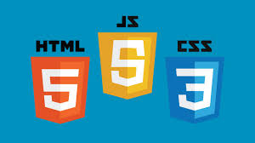
Technology Stack Behind the Game
HTML 5
For structuring the content and ensuring accessibility
CSS 3
For styling and creating an appealing visual design
JavaScript
For dynamic functionality and interactive elements.
These core web technologies deliver a seamless and engaging web experience.

Slide 6
Structure of the Project
index.html
Main webpage of the game, contains quiz layout. Displays questions, options, and buttons
style.css
Adds design, background image and styling
Colors, fonts, layout
Makes game attractive
script.js
Contains game logic
Stores questions and answers
Checks correct/incorrect answers and updates score

Slide 7
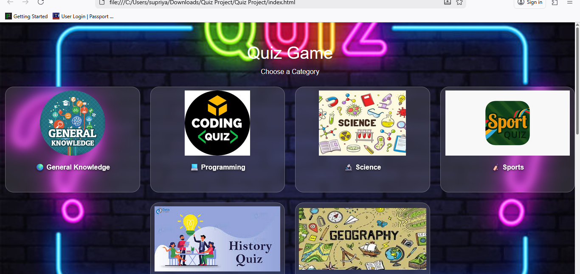
Quiz Game Home Page

Slide 8
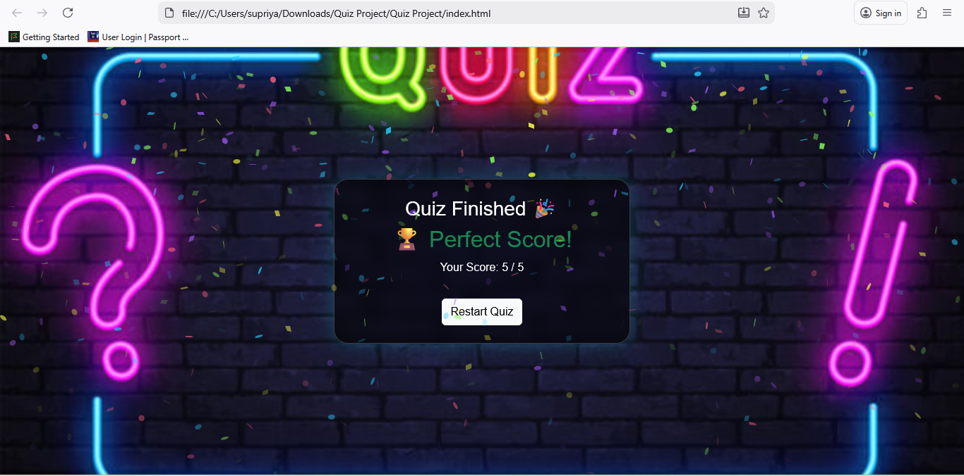
Quiz Result – Winning Screen
It displays user’s final score after successfully completing the quiz

Slide 9
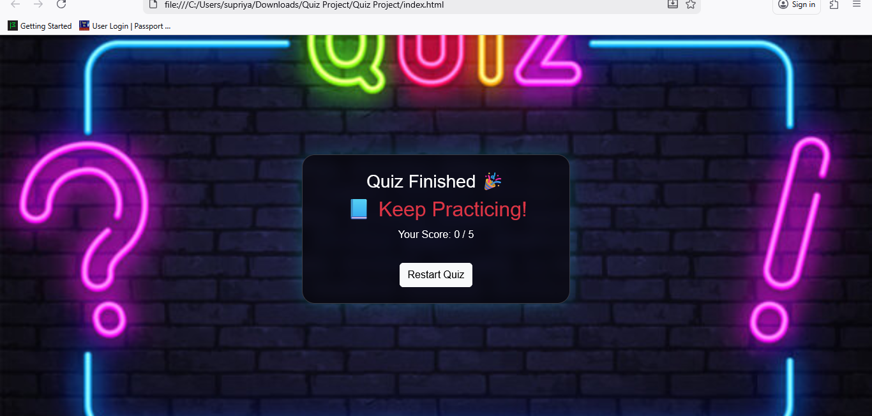
Quiz Result – Loss Screen
The loss screen displays the user’s final score if the quiz is not successfully completed

